Slide 1
ENM Crash Course:
Data Cleaning and Processing

Slide 2
What data are we using?

Slide 3
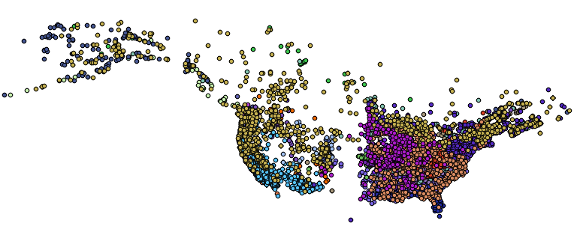
What data are we using?
1. Georeferenced occurrence records

Slide 4
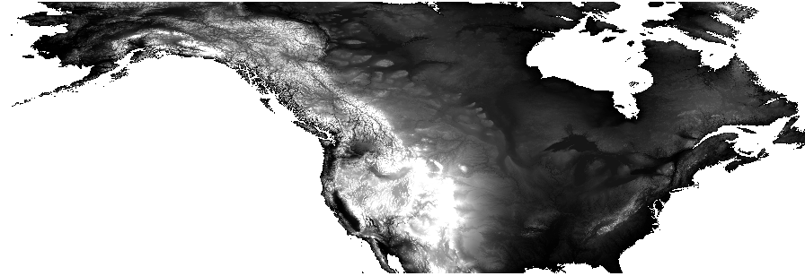
What data are we using?
2. Gridded abiotic data layers

Slide 5
Abiotic data layers
What kinds?
Temperature, precipitation, soil, vegetation, land use
Where?
Local, USA, North America, Global
When?
Past, current, future

Slide 6
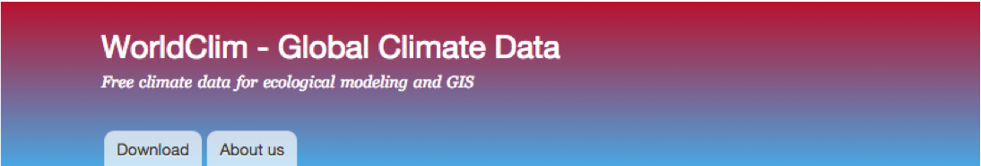

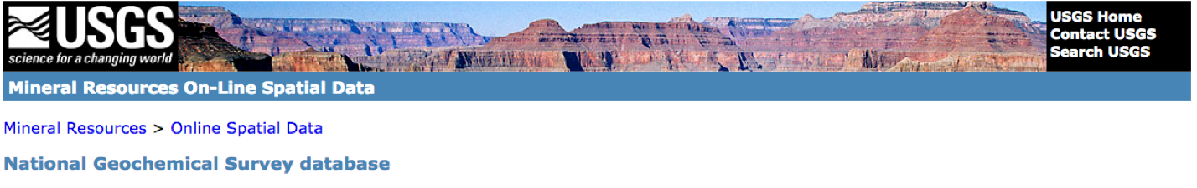
Data layer sources
WorldClim
PRISM
Unified North American Soil Map
USGS
EPA
NOAA
PMIP
AquaMaps

Slide 7
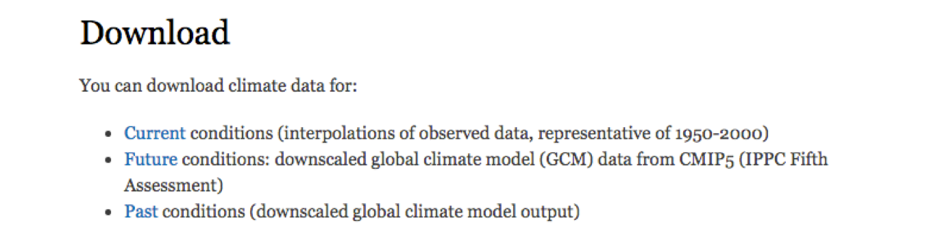
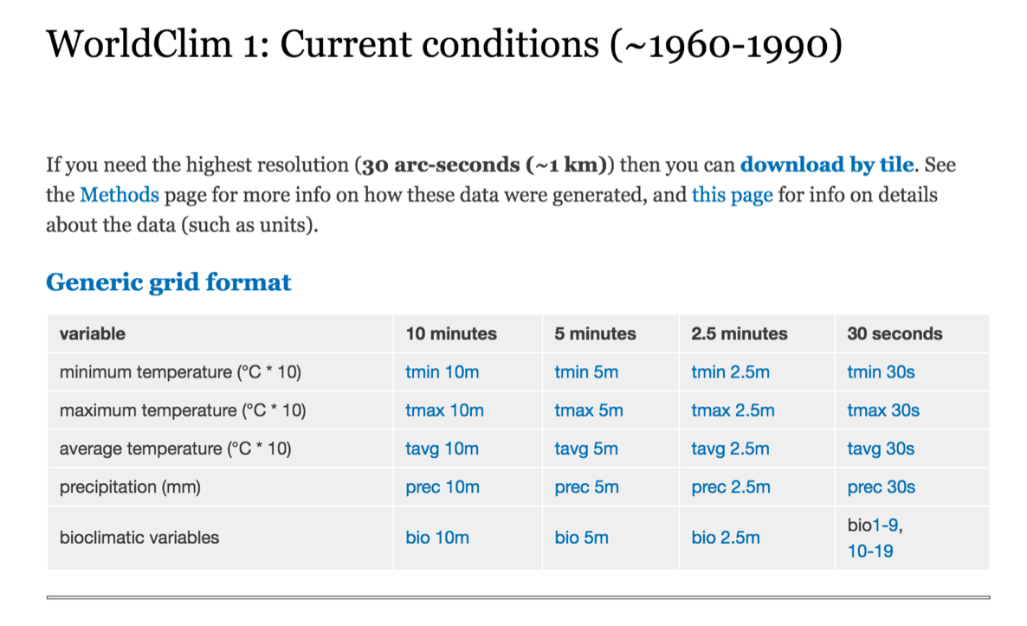
WorldClim
www.worldclim.org
Global climate data
Multiple resolutions
19 Bioclimatic variables derived from monthly temperature and rainfall values
Current conditions: averaged over past 50 years
Future conditions: climate projections from a number of global climate models with different greenhouse gas concentration trajectories
Past conditions: Mid-Holocene, Last Glacial Maximum, Last Inter-Glacial
WorldClim 2 now available, has same 19 + new variable layers

Slide 8
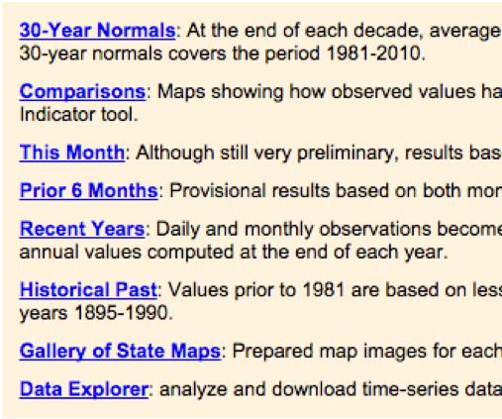
PRISM
www.prism.oregonstate.edu
Climate data for the US
More precise than WorldClim
Larger files, more work
Data available from 1895 to present
Lots of data and tools to explore

Slide 9
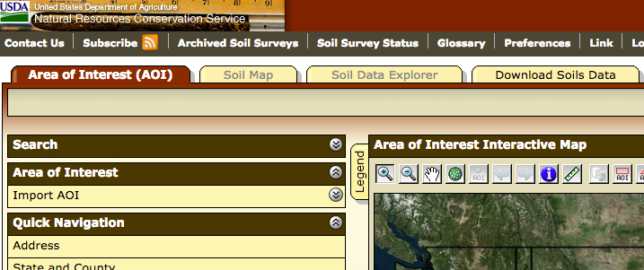
Soil Sources
SoilGrids2.0: https://soilgrids.org
Entire globe
Eight characteristics of topsoil and subsoil
2.5 arc second resolution
USGS: http://websoilsurvey.sc.egov.usda.gov/App/HomePage.htm
US only
Need to define area of interest
Big files and tough to get large areas

Slide 10
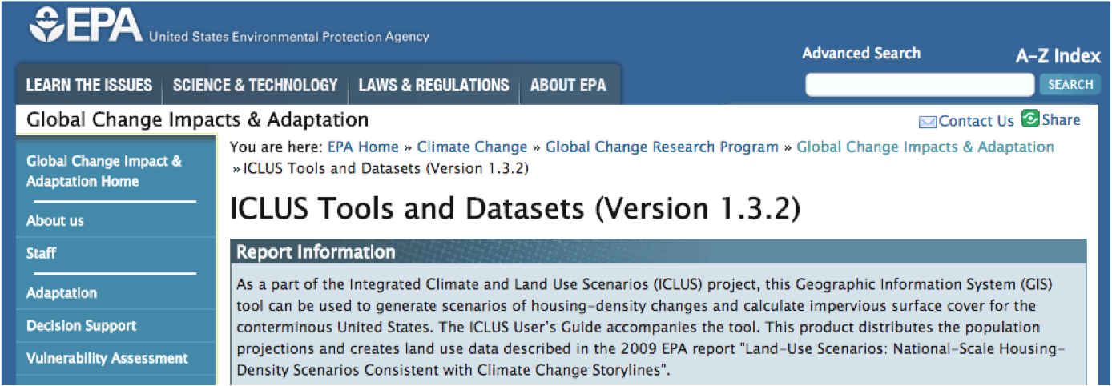
EPA
http://cfpub.epa.gov/ncea/global/recordisplay.cfm?deid=257306
Land use
County population projections
Housing density projections
Percent impervious surface projections

Slide 11
Other resources
Paleoclimate data
NOAA (NCEI):https://www.ncdc.noaa.gov/data-access/paleoclimatology-data/datasets
PMIP: https://pmip.lsce.ipsl.fr/
PaleoClim: http://paleoclim.org/
Aquatic Environments
AquaMaps: http://www.aquamaps.org/main/envt_data.php

Slide 12
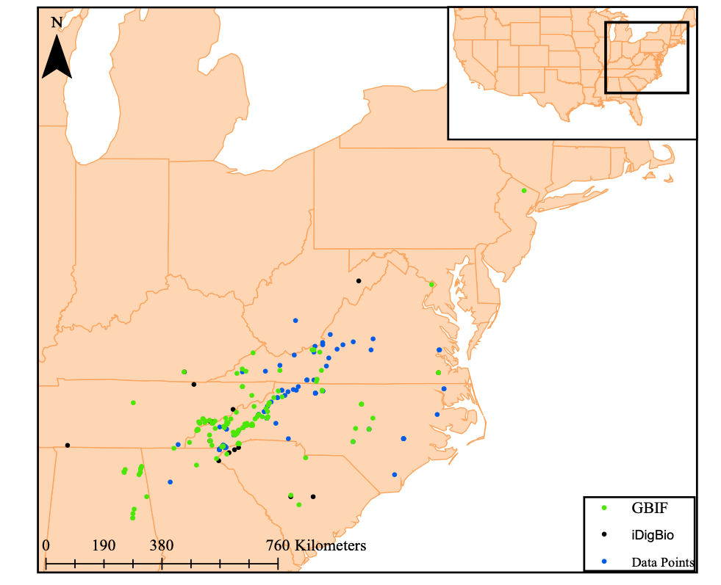
Cleaning Climatic Layers

Slide 13
Training Layer
Convex hull with Buffer

Slide 14

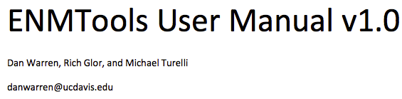
Layer Processing
Need layers in ASCII format
Clip layers to fit your desired range

Slide 15

Layer Processing
Need layers in ASCII format
Clip layers to fit your desired range
Pairwise correlation analysis to check for highly correlated layers
Selection of uncorrelated layers
ClimateProcessing.R

Slide 16
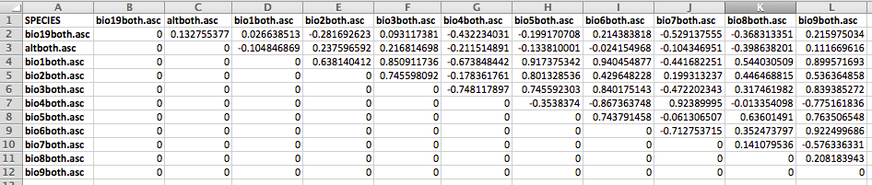
Selection of Uncorrelated Layers

Slide 17
Selection of Uncorrelated Layers

Slide 18
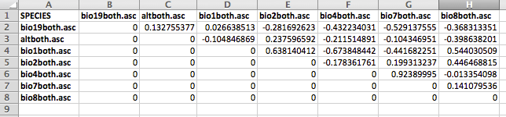
Selection of Uncorrelated Layers

Slide 19
Go through the Climate Processing section
Try QGIS out
See ENMWorkshop_2020.docx for a step-by-step guide
Run the ClimateProcessing.R script

Slide 20
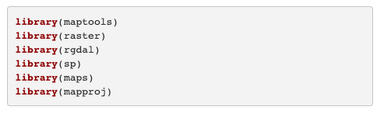
Load Packages

Slide 21
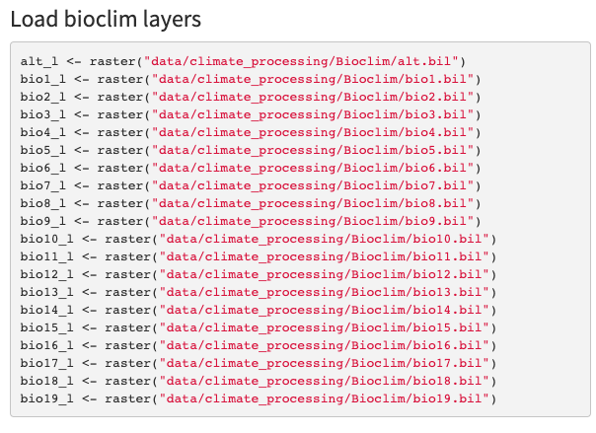
Load bioclim layers

Slide 22
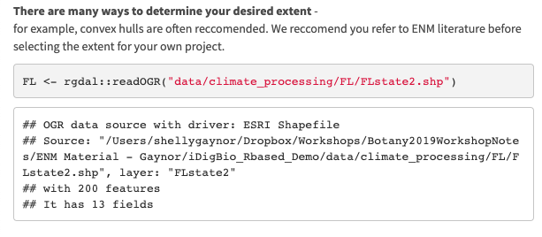
Set desired extent

Slide 23
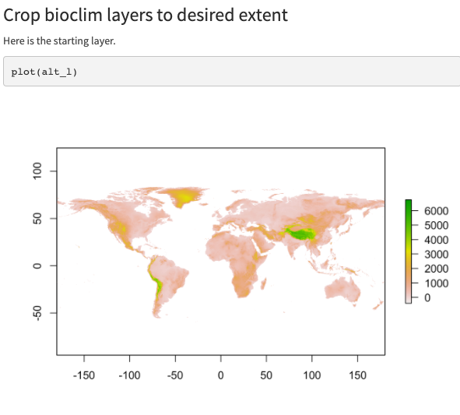
Crop bioclim layer to desired extent

Slide 24
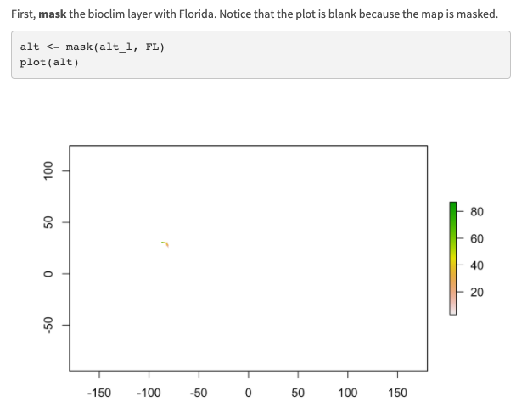
Crop bioclim layer to desired extent

Slide 25
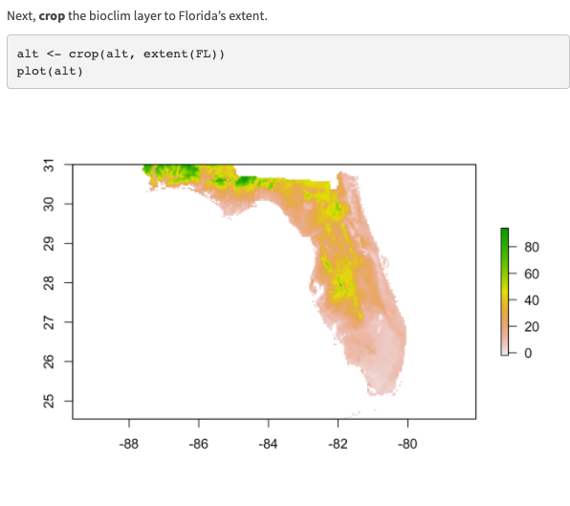
Crop bioclim layer to desired extent

Slide 26
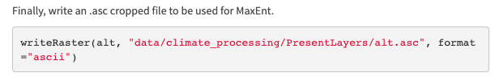
Save as raster

